Slide 1


NCR COMMERCE HACKATHON 2019
Personalization/recommendation using behavioral data
Team Name: < Team Name >
Subhash Eedarapalli
Ananya Deshmukh
Aravind Kadaverugu
Tejaswini Vissamsetti

Slide 2
Problem
Personalization/recommendation using behavioral data
Solution
Analyzing the customer’s purchasing behavior and recommend relevant products recommendations as he shops.
NCR Corporate Story © NCR Confidential
Notes:
Background information for presenter- this is the call to action for you to begin your discussion

Slide 3

Solution
Collaborative Filtering Model is based assumption that people like things similar to other things they like and things that are liked by other people with similar taste. There are Types of collaborative filtering techniques
Item-based Collaborative Filtering
User-based Collaborative Filtering
NCR Corporate Story © NCR Confidential
Notes:
Background information for presenter- this is the call to action for you to begin your discussion

Slide 4
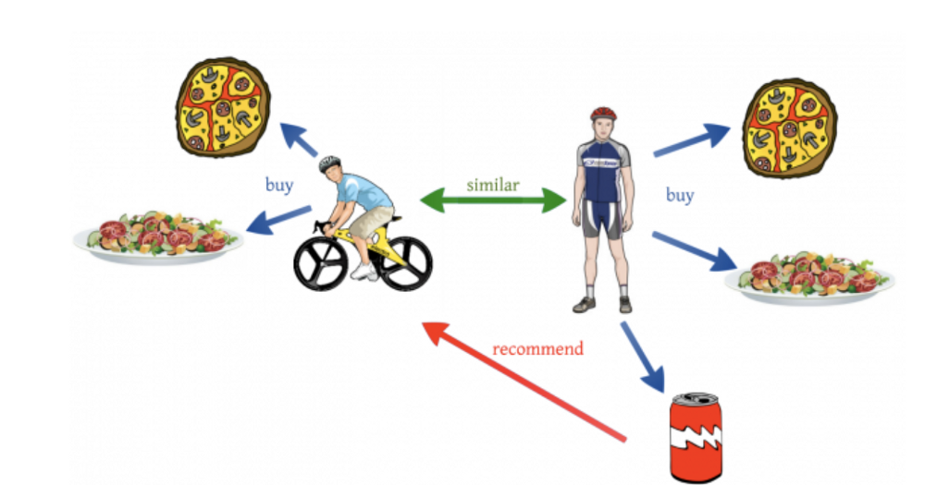
User-Based Filtering
A user-based filtering takes a particular user, find users that are similar to that user based on similarity of ratings, and recommend items that those similar users liked.
User-based Collaborative Filtering: “Users who are similar to you also liked .
Challenges:
Sparsity
Scalability

Slide 5
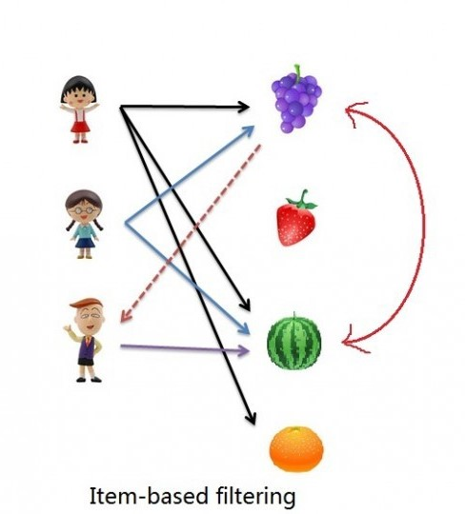
Item–Based Filtering:
In contrast, item-based filtering will take an item, find users who liked that item, and find other items that those users or similar users also liked. It takes items and outputs other items as recommendations.
Item-Item Collaborative Filtering: “Users who liked this item also liked.
IB-CF fills a Item -item matrix , and recommends based on similar items

Slide 6
Thank You

